Slide 1
Transport layer
PROCESS-TO-PROCESS DELIVERY
The transport layer is responsible for process-to-process delivery—the delivery of a packet, part of a message, from one process to another.

Slide 2

Note
The transport layer is responsible for process-to-process delivery.

Slide 3

Types of data deliveries

Slide 4

Port numbers

Slide 5

IP addresses versus port numbers

Slide 6

IANA ranges

Slide 7

Socket address

Slide 8

Error control

Slide 9

User Datagram
UDP packets, called user datagrams, have a fixed-size header of 8 bytes.

Slide 10


Well-known ports used with UDP

Slide 11
Note
UDP length
= IP length – IP header’s length

Slide 12

Pseudoheader for checksum calculation

Slide 13
Figure shows the checksum calculation for a very small user datagram with only 7 bytes of data. Because the number of bytes of data is odd, padding is added for checksum calculation. The pseudoheader as well as the padding will be dropped when the user datagram is delivered to IP.

Slide 14

Checksum calculation of a simple UDP user datagram

Slide 15
UDP Services
Process-to-Process Communication
Connectionless Services
  Only those processes sending short messages, messages less than 65,507 bytes (65,535 minus 8 bytes for the UDP header and minus 20 bytes for the IP header), can use UDP
Flow Control - There is no flow control
Error Control - There is no Error control
Checksum

Slide 16
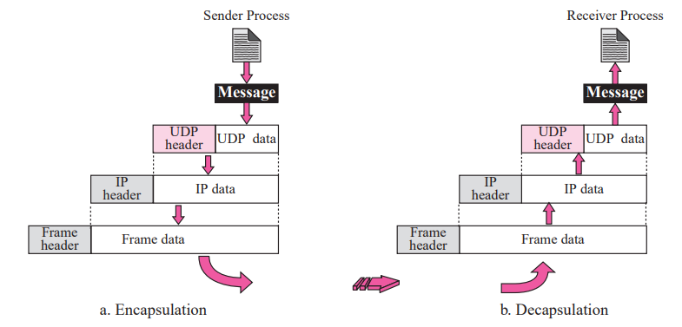
UDP Services
Encapsulation and Decapsulation

Slide 17

Queues in UDP

Slide 18

Multiplexing and Demultiplexing

Slide 19
UDP Applications
Connectionless Service
Lack of Error Control
Lack of Congestion Control
UDP is suitable for a process that requires simple request-response communication
UDP is a suitable transport protocol for multicasting.
UDP is used for some route updating protocols such as Routing Information Protocol (RIP)

Slide 20
TCP
TCP is a connection-oriented protocol; it creates a virtual connection between two TCPs to send data. In addition, TCP uses flow and error control mechanisms at the transport level.
TCP Services
Process-to-Process Communication
As with UDP, TCP provides process-to-process communication using port numbers

Slide 21
TCP Services
Process-to-Process Communication
Stream delivery
Full-Duplex Communication
Multiplexing and Demultiplexing
Connection-Oriented Service
Reliable Service

Slide 22

Well-known ports used by TCP

Slide 23

Stream delivery

Slide 24

Sending and receiving buffers

Slide 25

TCP segments

Slide 26
TCP Features
Numbering System
  sequence number and the acknowledgment number. These two fields refer to a byte number and not a segment number
Flow Control
Error Control
Congestion Control

Slide 27
Note
The bytes of data being transferred in each connection are numbered by TCP.
The numbering starts with a randomly generated number.

Slide 28

Example
The following shows the sequence number for each segment:

Slide 29
Note
The value in the sequence number field of a segment defines the
number of the first data byte
contained in that segment.

Slide 30
Note
The value of the acknowledgment field in a segment defines
the number of the next byte a party expects to receive.
The acknowledgment number is cumulative.

Slide 31

TCP segment format

Slide 32

Control field

Slide 33

Description of flags in the control field

Slide 34

Connection establishment using three-way handshaking

Slide 35
Note
A SYN segment cannot carry data, but it consumes one sequence number.

Slide 36
Note
A SYN + ACK segment cannot
carry data, but does consume one
sequence number.

Slide 37
Note
An ACK segment, if carrying no data, consumes no sequence number.

Slide 38

Data transfer

Slide 39

Connection termination using three-way handshaking

Slide 40
Note
The FIN segment consumes one sequence number if it does
not carry data.

Slide 41
Note
The FIN + ACK segment consumes
one sequence number if it
does not carry data.

Slide 42

Half-close

Slide 43

Sliding window

Slide 44
Note
A sliding window is used to make transmission more efficient as well as
to control the flow of data so that the destination does not become
overwhelmed with data.
TCP sliding windows are byte-oriented.

Slide 45
Example
What is the value of the receiver window (rwnd) for host A if the receiver, host B, has a buffer size of 5000 bytes and 1000 bytes of received and unprocessed data?
Solution
The value of rwnd = 5000 − 1000 = 4000. Host B can receive only 4000 bytes of data before overflowing its buffer. Host B advertises this value in its next segment to A.

Slide 46
Example
What is the size of the window for host A if the value of rwnd is 3000 bytes and the value of cwnd is 3500 bytes?
Solution
The size of the window is the smaller of rwnd and cwnd, which is 3000 bytes.

Slide 47
Example
Figure shows an unrealistic example of a sliding window. The sender has sent bytes up to 202. We assume that cwnd is 20 (in reality this value is thousands of bytes). The receiver has sent an acknowledgment number of 200 with an rwnd of 9 bytes (in reality this value is thousands of bytes). The size of the sender window is the minimum of rwnd and cwnd, or 9 bytes. Bytes 200 to 202 are sent, but not acknowledged. Bytes 203 to 208 can be sent without worrying about acknowledgment. Bytes 209 and above cannot be sent.

Slide 48

Example

Slide 49
Note
Some points about TCP sliding windows:
❏ The size of the window is the lesser of rwnd and
cwnd.
❏ The source does not have to send a full window’s
worth of data.
❏ The window can be opened or closed by the
receiver, but should not be shrunk.
❏ The destination can send an acknowledgment at
any time as long as it does not result in a shrinking
window.
❏ The receiver can temporarily shut down the
window; the sender, however, can always send a
segment of 1 byte after the window is shut down.

Slide 50
Note
ACK segments do not consume sequence numbers and are not acknowledged.

Slide 51
Note
In modern implementations, a retransmission occurs if the retransmission timer expires or three duplicate ACK segments have arrived.

Slide 52
Note
No retransmission timer is set for an ACK segment.

Slide 53
Note
Data may arrive out of order and be temporarily stored by the receiving TCP,
but TCP guarantees that no out-of-order segment is delivered to the process.

Slide 54

Normal operation

Slide 55

Lost segment

Slide 56
Note
The receiver TCP delivers only ordered data to the process.

Slide 57

Fast retransmission

Slide 58
Congestion Control
An important issue in the Internet is congestion.
Congestion in a network may occur if the load on the network—the number of packets sent to the network—is greater than the capacity of the network—the number of packets a network can handle.
Congestion control refers to the mechanisms and techniques to control the congestion and keep the load below the capacity.

Slide 60
AIMD
(Additive Increase / Multiplicative Decrease)
CongestionWindow (cwnd) is a variable held by the TCP source for each connection.
cwnd is set based on the perceived level of congestion. The Host receives implicit (packet drop) or explicit (packet mark) indications of internal congestion.
MaxWindow :: min (CongestionWindow , AdvertisedWindow)

Slide 61
Additive Increase
Additive Increase is a reaction to perceived available capacity.
Linear Increase basic idea:: For each “cwnd’s worth” of packets sent, increase cwnd by 1 packet.
In practice, cwnd is incremented fractionally for each arriving ACK.
increment = MSS x (MSS /cwnd)
cwnd = cwnd + increment

Slide 62
Figure Additive Increase
Source
Destination
Add one packet
each RTT

Slide 63
Multiplicative Decrease
The key assumption is that a dropped packet and the resultant timeout are due to congestion at a router or a switch.
Multiplicate Decrease:: TCP reacts to a timeout by halving cwnd.
Although cwnd is defined in bytes, the literature often discusses congestion control in terms of packets (or more formally in MSS == Maximum Segment Size).
cwnd is not allowed below the size of a single packet.

Slide 64
AIMD
(Additive Increase / Multiplicative Decrease)
It has been shown that AIMD is a necessary condition for TCP congestion control to be stable.
Because the simple CC mechanism involves timeouts that cause retransmissions, it is important that hosts have an accurate timeout mechanism.
Timeouts set as a function of average RTT and standard deviation of RTT.
However, TCP hosts only sample round-trip time once per RTT using coarse-grained clock.

Slide 65
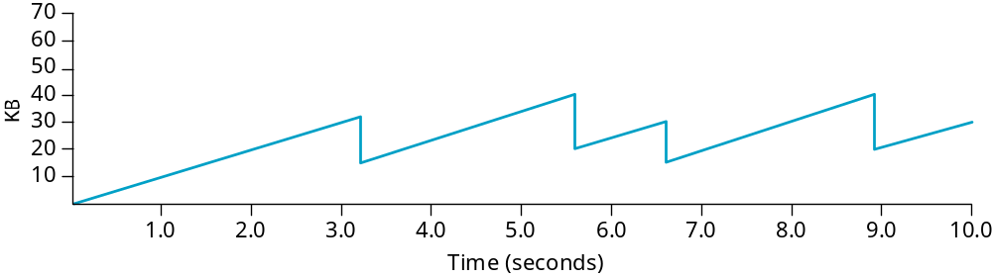
Typical TCP Sawtooth Pattern

Slide 66
Slow Start
Linear additive increase takes too long to ramp up a new TCP connection from cold start.
Beginning with TCP Tahoe, the slow start mechanism was added to provide an initial exponential increase in the size of cwnd.
Remember mechanism by: slow start prevents a slow start. Moreover, slow start is slower than sending a full advertised window’s worth of packets all at once.

Slide 67
Slow Start
The source starts with cwnd = 1.
Every time an ACK arrives, cwnd is incremented.
cwnd is effectively doubled per RTT
Two slow start situations:
  At the very beginning of a connection {cold start}.
  When the connection goes dead waiting for a timeout to occur (i.e, the advertized window goes to zero!)

Slide 68
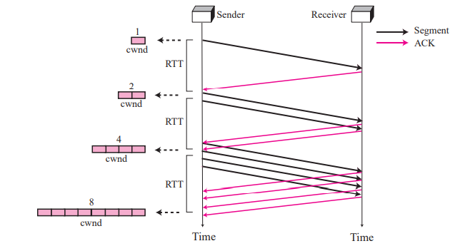
Slow Start: Exponential Increase

Slide 69
Slow Start
However, in the second case the source has more information. The current value of cwnd can be saved as a congestion threshold.
This is also known as the “slow start threshold” ssthresh.

Slide 70
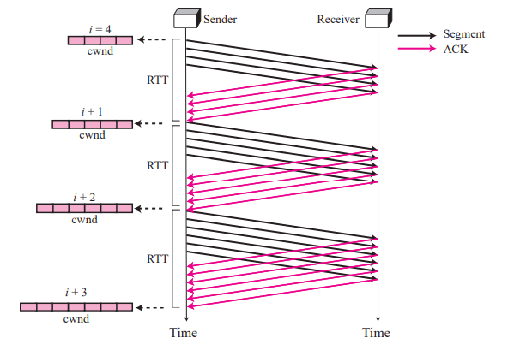
Congestion avoidance, additive increase

Slide 71
Congestion Detection: Multiplicative Decrease
size of the threshold is dropped to half (multiplicative decrease).

Slide 72
Consider an instance of TCP’s Additive Increase Multiplicative Decrease(AIMD) algorithm where the window size at the start of the slow start phase is 2 MSS and the threshold at the start of the first transmission is 8 MSS. Assume that a time out occurs during the fifth transmission. Find the congestion window size at the end of the tenth transmission.

Slide 73
Since Slow Start is used, window size is increased by the number of segments successfully sent. This happens until either threshold value is reached or time out occurs.
In both of the above situations AIMD is used to avoid congestion. If threshold is reached, window size will be increased linearly.
If there is timeout, window size will be reduced to half.

Slide 74
Window size for 1st transmission = 2 MSS
Window size for 2nd transmission = 4 MSS
Window size for 3rd transmission = 8 MSS
threshold reached, increase linearly (according to AIMD)
Window size for 4th transmission = 9 MSS
Window size for 5th transmission = 10 MSS
time out occurs, resend 5th with window size starts with as slow start.
Window size for 6th transmission = 2 MSS
Window size for 7th transmission = 4 MSS
threshold reached, now increase linearly (according to AIMD)
Additive Increase: 5 MSS (since 8 MSS isn’t permissible anymore)
Window size for 8th transmission = 5 MSS
Window size for 9th transmission = 6 MSS
Window size for 10th transmission = 7 MSS

